Slide 1


Slide 2
GPS & ITS APPLICATIONS IN OPENCAST MINE SURVEYING
DEVELOPED BY US DoD BASICALLY
FOR MILITARY USES
- COST OF THE SYSTEM – US $ 12 bn
MANAGED/ OPERATED BY US AIR
FORCE’S SPACE SQUADRONS

Slide 3
Three Segments
SPACE-SEGMENT
L1, L2, Time
Add Info
USER-SEGMENT
Receive Satellite Signal
CONTROL-SEGMENT
Central
Time Synchronisation
Tracking Stations

Slide 4

Satellite Constellation
24 Satellites
6 Orbital Planes
55º Inclination to the Equator
20,200 km above Earth
12 hour orbits

Slide 5
Satellite Signal
Fundamental
Frequency
10.23 MHz
÷ 10
L1
1575.42 MHz
C/A Code
1.023 MHz
P-Code
10.23 MHz
x 154
L2
1227.60 MHz
P-Code
10.23 MHz
x 120

Slide 6
USER SEGMENT
USER SEGMENT
Total User Community
        - On Land
        - In the air
        - On the sea
To observe and record the signals from the satellites and to obtain their own real time positions for navigation and more accurate positions for Geodetic surveying purposes

Slide 7
CONTROL SEGMENT
Master Control Station
(At FAFB Colarado, USA)
5 Monitoring Stations at FAFB, Hawaii Islands, Ascension Islands, Diego Garcia, and Kwaljelain Islands
18 Trekking Stations all over the world
To monitor satellite positions accurately and continuously
To predict satellite ephemeries
To update the ephemeries and satellite messages periodically , and
To calibrate the satellite cloaks

Slide 8
Outline Principle - Range
Time taken x speed of light = range

Slide 9
Outline Principle – Position
3 ranges to resolve - latitude, longitude, and height
4th range to resolve - receiver clock offset

Slide 10
SOURCES OF ERRORS IN GPS
1.SATELLITE ERRORS
a) Orbittal Errors --- Differential measurements
b) Clock Errors --- Differential measurements
2. ATMOSPHERIC ERRORS
a) Delayed Signals --- Corrections
b) Multi path Errors --- Filters
3. RECEIVER ERRORS
a) Clock Errors --- Differential measurements
b) Internal Noise --- Prolonged Observations
4. INTRODUCED OR INTERNATIONAL ERRORS
A) Selective Availability --- Differential measurements
b) Anti- Sfooging --- Decrypting keys
5. GEOMETRICAL ERRORS
Geometrical Dilution of Precision – Observations when satellites are in good geometry - -- GDOP < 8

Slide 11

Accuracy - one receiver - navigation position only
Absolute Position...accurate in meters

Slide 12
Accuracy - 2 receivers - DGPS and GPS Surveying
Z
P
Q
X
Y
Differential GPS
Differential - Errors eliminated - Relative Position good

Slide 13
Code - Pseudorange - DGPS - low accuracy - 1 to 5m
Time Offset

Slide 14
Phase - GPS surveying - high accuracy - 3 - 10mm
N
Ø
N x wavelength + Ø = range

Slide 15
GPS RECEIVERS
A ) CODE CORRELATION RECEIVERS
Observes Pseudo-range and Phase- shift
Used for precise point positioning.
B ) CODELESS SQUARRING RECEIVERS
Observable Only phase- shift
Used for relative positions of points.

Slide 16
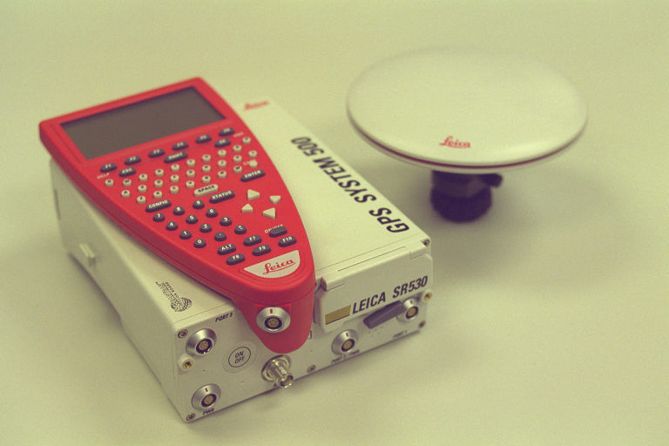
GPS PROCESSOR & ANTENNAE

Slide 17
GPS ANTENNAE
A ) SENSOR
To receive, amplify and transmit the signal to the controller through a cable.
B ) CONTROLLER
To handle and process the data in the micro- processor of the controller,
To store the data,
To display the data,
For interactive dialogue,
To transfer the data to Computer.

Slide 18
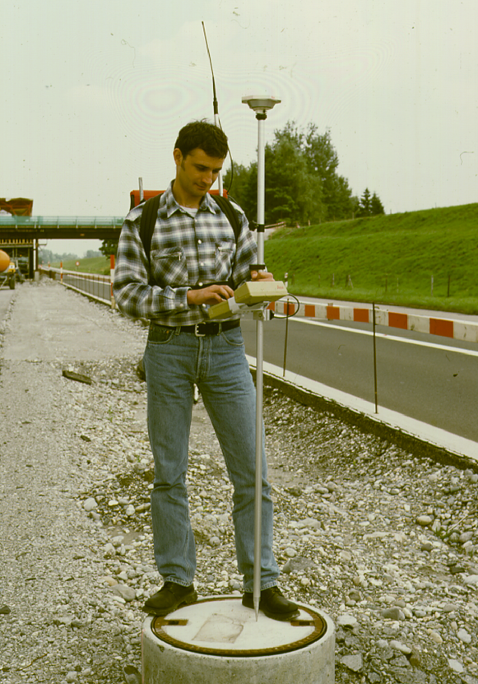
GPS PROCESSOR & ANTENNAE

Slide 19
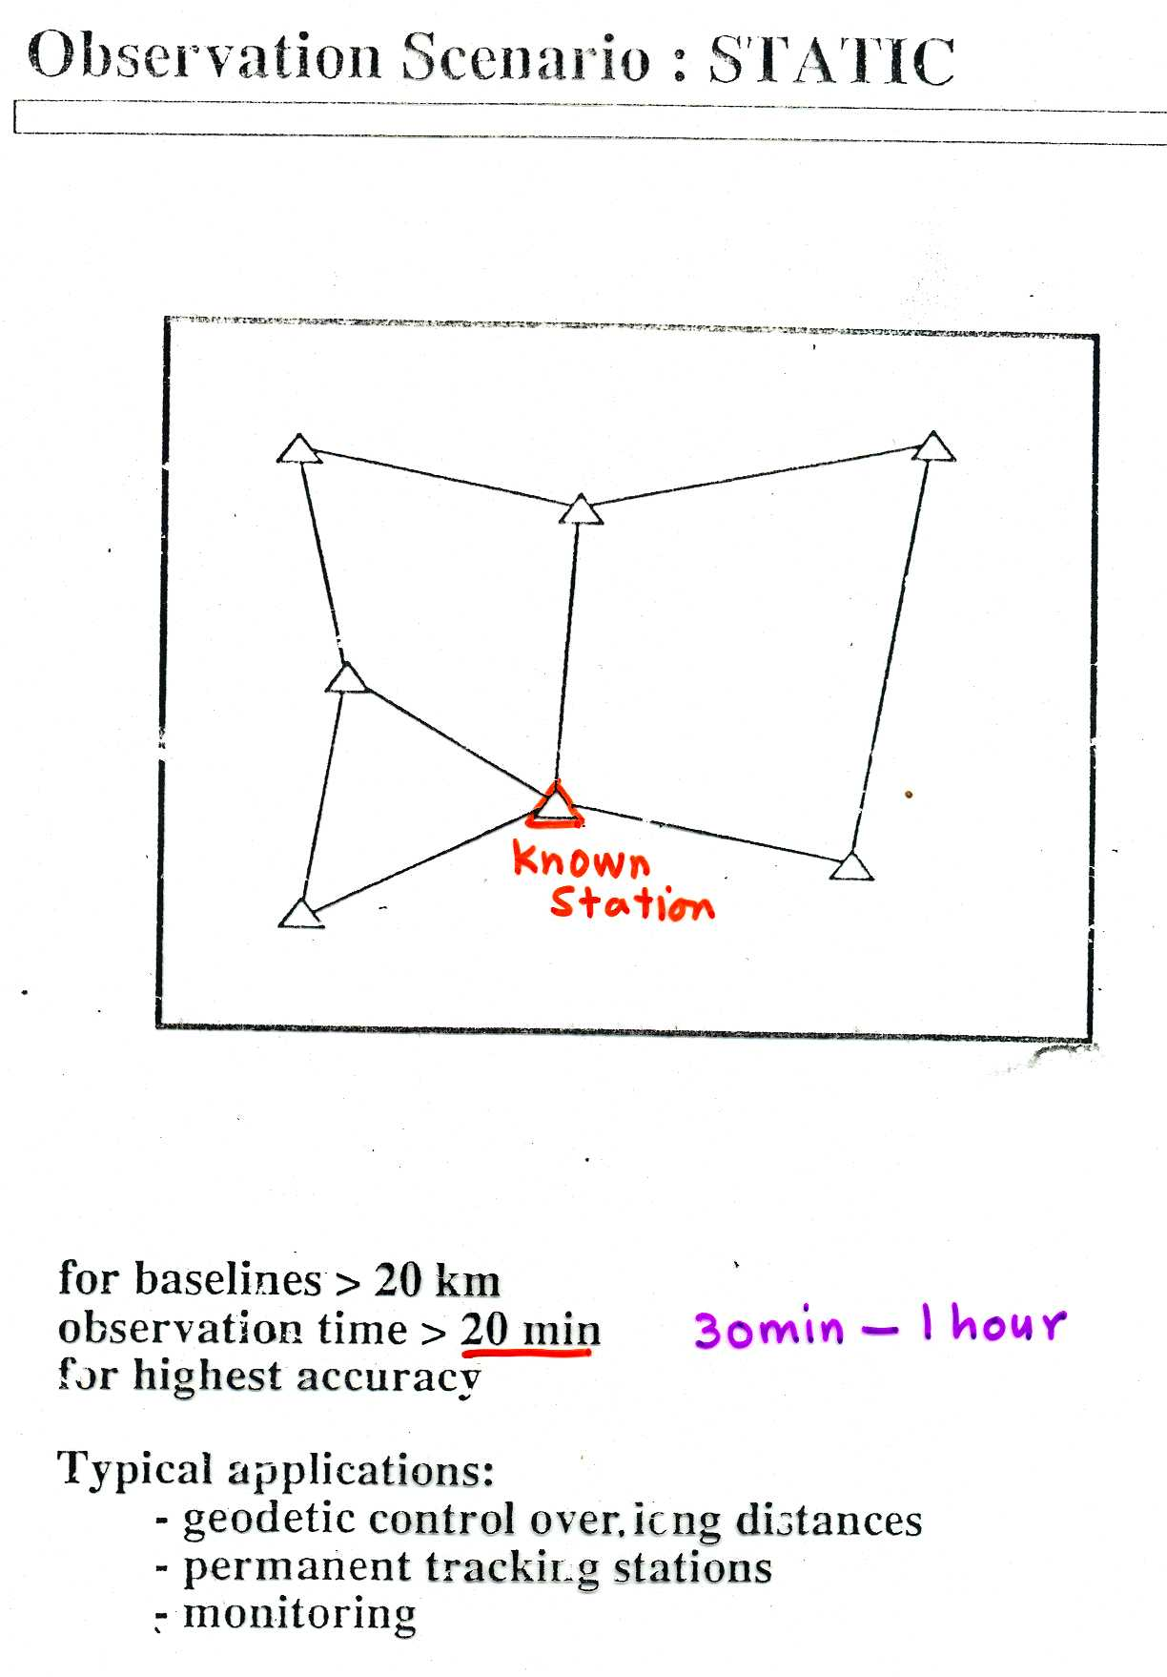

Slide 20
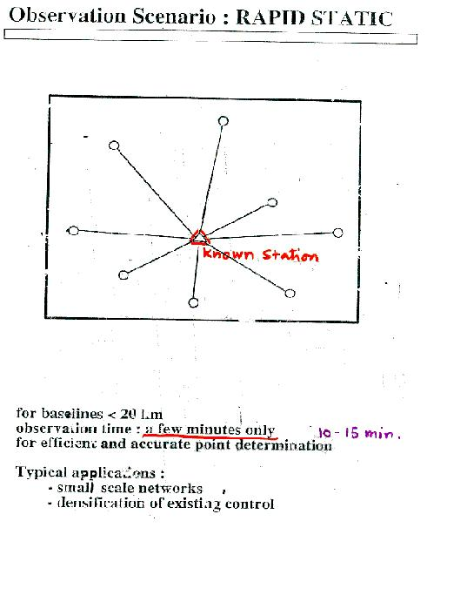

Slide 21
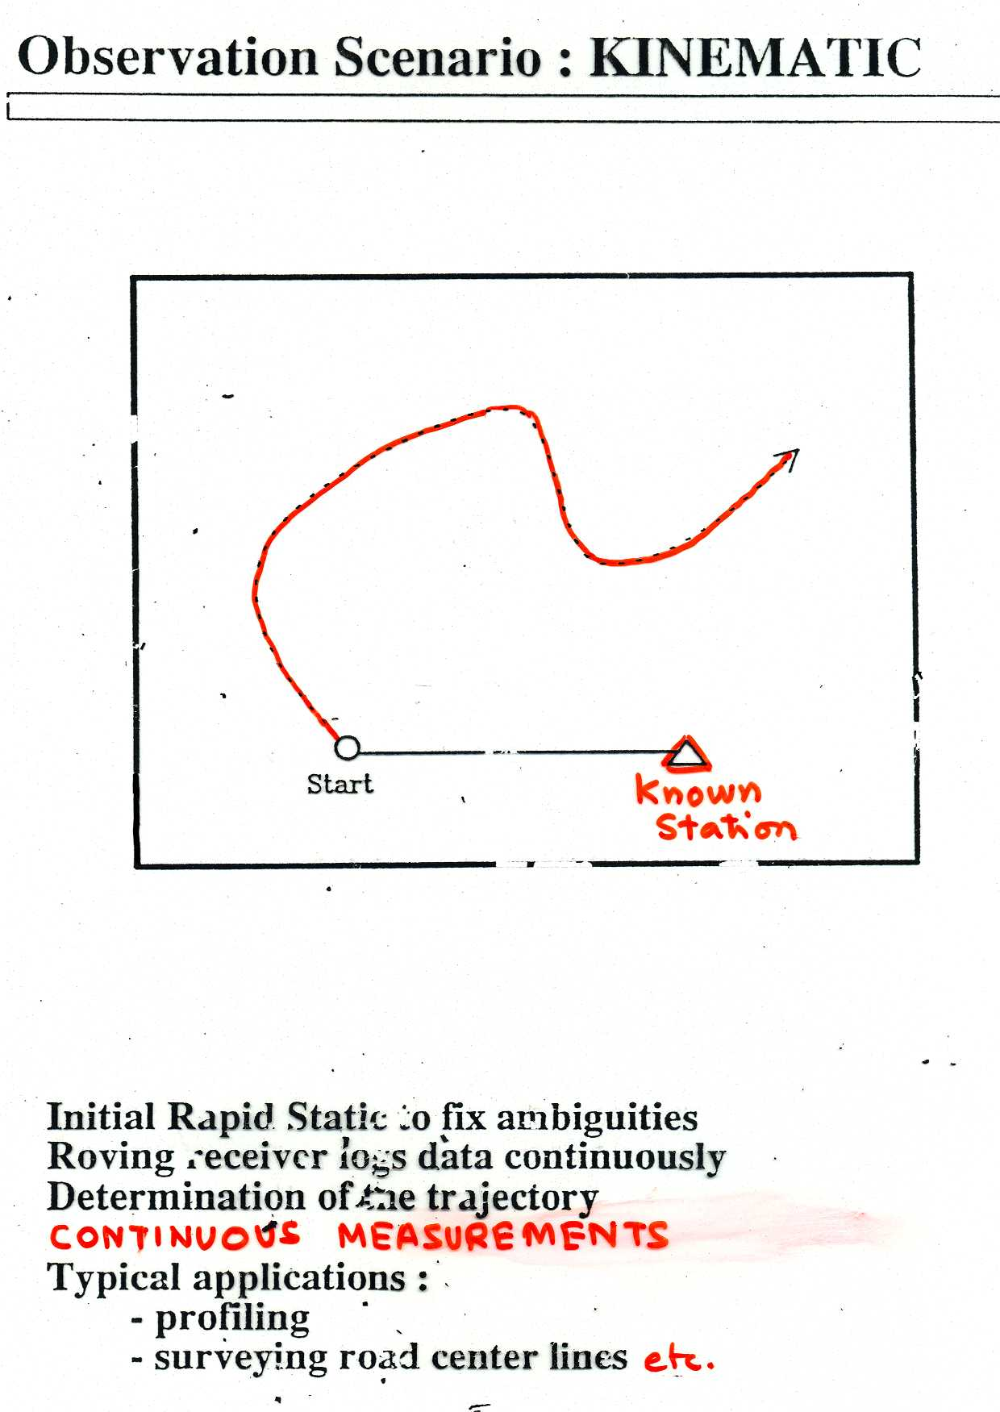

Slide 22
ADVANTAGES & LIMITATIONS OF GPS
ADVANTAGES
1. SATTION ‘S INTERVISIBILITY NOT REQUIRED.
2. FLEXIBLE SITE SELECTION FOR STATIONS.
3. REDUCTION IN NUMBER OF SITES.
4. RANGE INDEPENDENT.
5. WEATHER INDEPENDENT.
6. EASE OF OPERATION AND EASILY PORTABLE.
7. DAY AND NIGHT OBSERVATION POSSIBLE.
8. ANY NUMBER OF USERS, NO LICENCE FEE.
9. EASE OF POST-PROCESSING, ON-LINE EVLUATION.
10. GEODETIC ACCURACY, LESS MAN-POWER.
11. ECONOMICAL IN LONG RUN.
LIMITATIONS
1. CLEAR VIEW OF SKY IS NEEDE SO NOT USEFUL IN THE U/G. OR WITH THE
OBSTRUCTED SITES.
2. DISTURBANCES FROM THE RADIO TRANSMISSION AND BIG ANTENNAE.

Slide 23
APPLICATION OF GPS IN MINE SURVEYING
1. SURVEYING THE POSITIONS OF BENCHES
2. SURVEYING THE POSITIONS OF WORKING FACES
3. MONITORING THE POSITIONS OF VARIOUS MACHINES IN THE MINE.
4. MEASUREMENT OF OVERBURDEN DUMPS / STOCKPILES.
5. PREPARATION OF SURFACE PLAN
6. PROVIDING CONTROL POINTS
7. DELINEATING THE POSITION OF WATER IN THE SUMP.
8. UPDATING MINE’S INFORMATION SYSTEM.
9. SURVEYING THE POSITIONS OF BORE-HOLES, DRILLING SITES ETC.
10. STRENGTHENING SURVEY CONTROL NETWORK

Slide 24
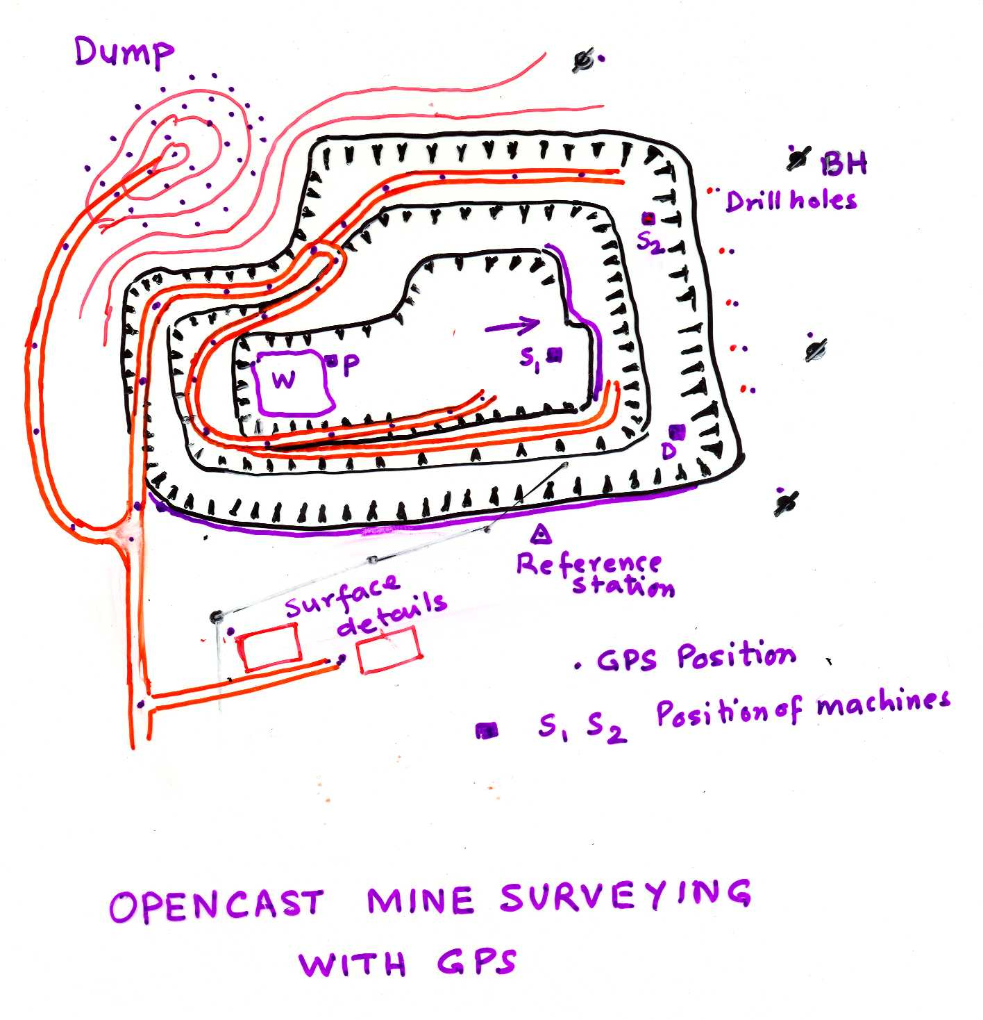

Slide 25
Point Point Easting Northing Ortho. Posn. Height.
Id Class Ht. Qlty. Qlty.
10A Reference 83618.9205 104720.2333 197.6439 0.0000 0.0000
10A 1 Measured 83450.8693 104720.9697 187.1076 0.0003 0.0005
BHL 1 Measured 82515.4627 104549.8677 193.8700 0.0004 0.0011
BHL 4 Measured 82574.6732 104581.8999 194.3791 0.0008 0.0017
BHL 5 Measured 82485.9236 104634.6124 196.9601 0.0009 0.0015
BHL 6 Measured 83085.2692 104522.3912 184.7158 0.0003 0.0009
7 Measured 83001.0006 104449.9227 184.0948 0.0005 0.0011
Point Point Easting Northing Ortho. Posn. Height.
Id Class Ht. Qlty. Qlty.
T54 Reference 91126.6936 96993.2376 191.5629 0.0000 0.0000
GPS2 Measured 90821.3166 97059.4925 175.7788 0.0006 0.0012
GPS1 Measured 90699.7843 96930.8666 174.6760 0.0004 0.0007
110 Measured 90009.6646 95942.0134 162.7349 0.0004 0.0011
109 Measured 90527.3584 95892.8839 179.1871 0.0007 0.0012
GPS7 Measured 92028.9733 96979.6996 180.4154 0.0006 0.0013
GPS8 Measured 92081.6323 96939.9402 177.3381 0.0003 0.0008
GPS5 Measured 92361.3071 96950.2358 185.4642 0.0007 0.0010
T53 Measured 91342.3084 98509.7842 196.3371 0.0004 0.0009
GPS3 Measured 91104.2742 98515.9678 181.3386 0.0006 0.0012

Slide 26
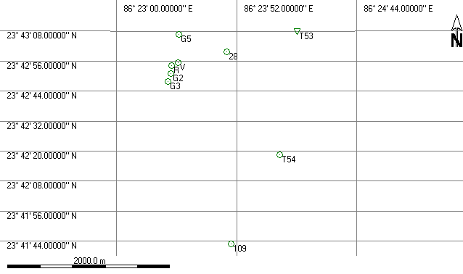
Point Point Easting Northing Ortho. Posn. Height.
Id Class Ht. Qlty. Qlty.
T53 Reference 91342.3117 98509.7866 196.3374 0.0000 0.0000
T54 Measured 91126.6853 96993.2337 191.5625 0.0003 0.0008
109 Measured 90527.3634 95892.8855 179.1872 0.0005 0.0009
28 Measured 90475.5506 98261.3191 174.0127 0.0003 0.0005
G3 Measured 89746.0960 97893.4015 167.1062 0.0003 0.0008
G2 Measured 89783.0628 97997.6761 173.9254 0.0003 0.0011
R Measured 89796.2401 98094.6237 171.1917 0.0011 0.0022
V Measured 89871.5170 98128.9309 171.1886 0.0011 0.0026
G5 Measured 89886.8067 98474.5333 170.9743 0.0006 0.0010

Slide 27
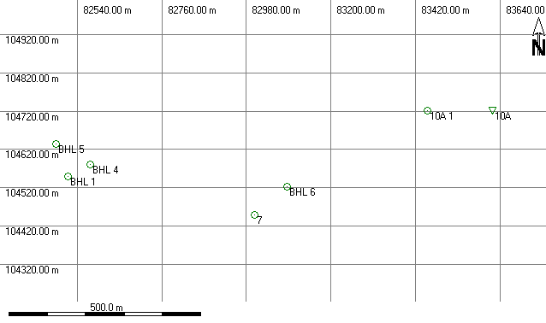
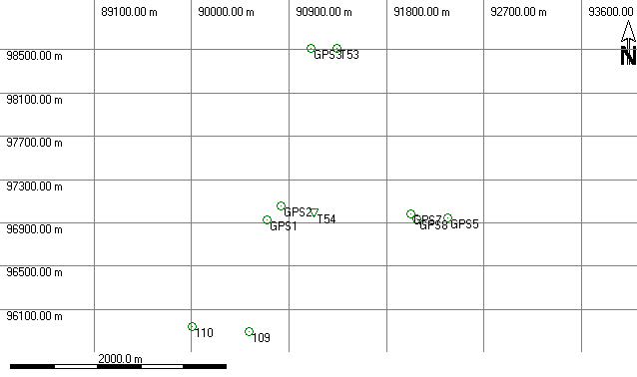

Slide 28
GPS MODES FOR OCM SURVEYING
APPLICATION | GPS MODE | ACCURACY | REFERENCE
POSITION OF BENCHES, FACES ETC. | CONTINUOUS KINEMATICS | HOR. 10 – 20 mm VERT. 20-40 mm | COOMBE (1997) KEUNE (1997)
SURFACE PLANS, POSITIONS OF MACHINES ETC. | KINEMATICS OR STOP & GO | HOR. 10 – 20 mm VERT. 20-40 mm | REGICHENBASH (1997), GREGORY (1997)
POSITIONS OF BOREHOLE CONTROL DESIFICATION | RAPID- STATIC | HOR. 5mm +/- 2 PPM VERT. 10 mm +/- 2PPM | CHRAZANOWSKI (1991) HEIN & RIEDLE CMPDIL (’96)
PRIMARY CONTROL WORK | STATIC | HOR. 5mm +/- 1 PPM VERT. 10 mm +/- 2PPM | WAUGH (1997)

